Slide 1
Week-11: Gladiators
Team Members: Shivani Asokumar, Akash Narang, Mit Jain, Juhi Malkani
Team Lead: Mit Jain

Slide 2

Project: E-commerce Website for Footwear

Slide 3
Team Progress Update
New: Static Login page
New: Seller page/add product
New: filter by brands, style, material
Shopping Cart feature
Frontend
New: Auth module
Seller Page APIs (completed)
Individual Product Page, Shopping Cart APIs (Completed)
New: Website can be hosted
Backend

Slide 4
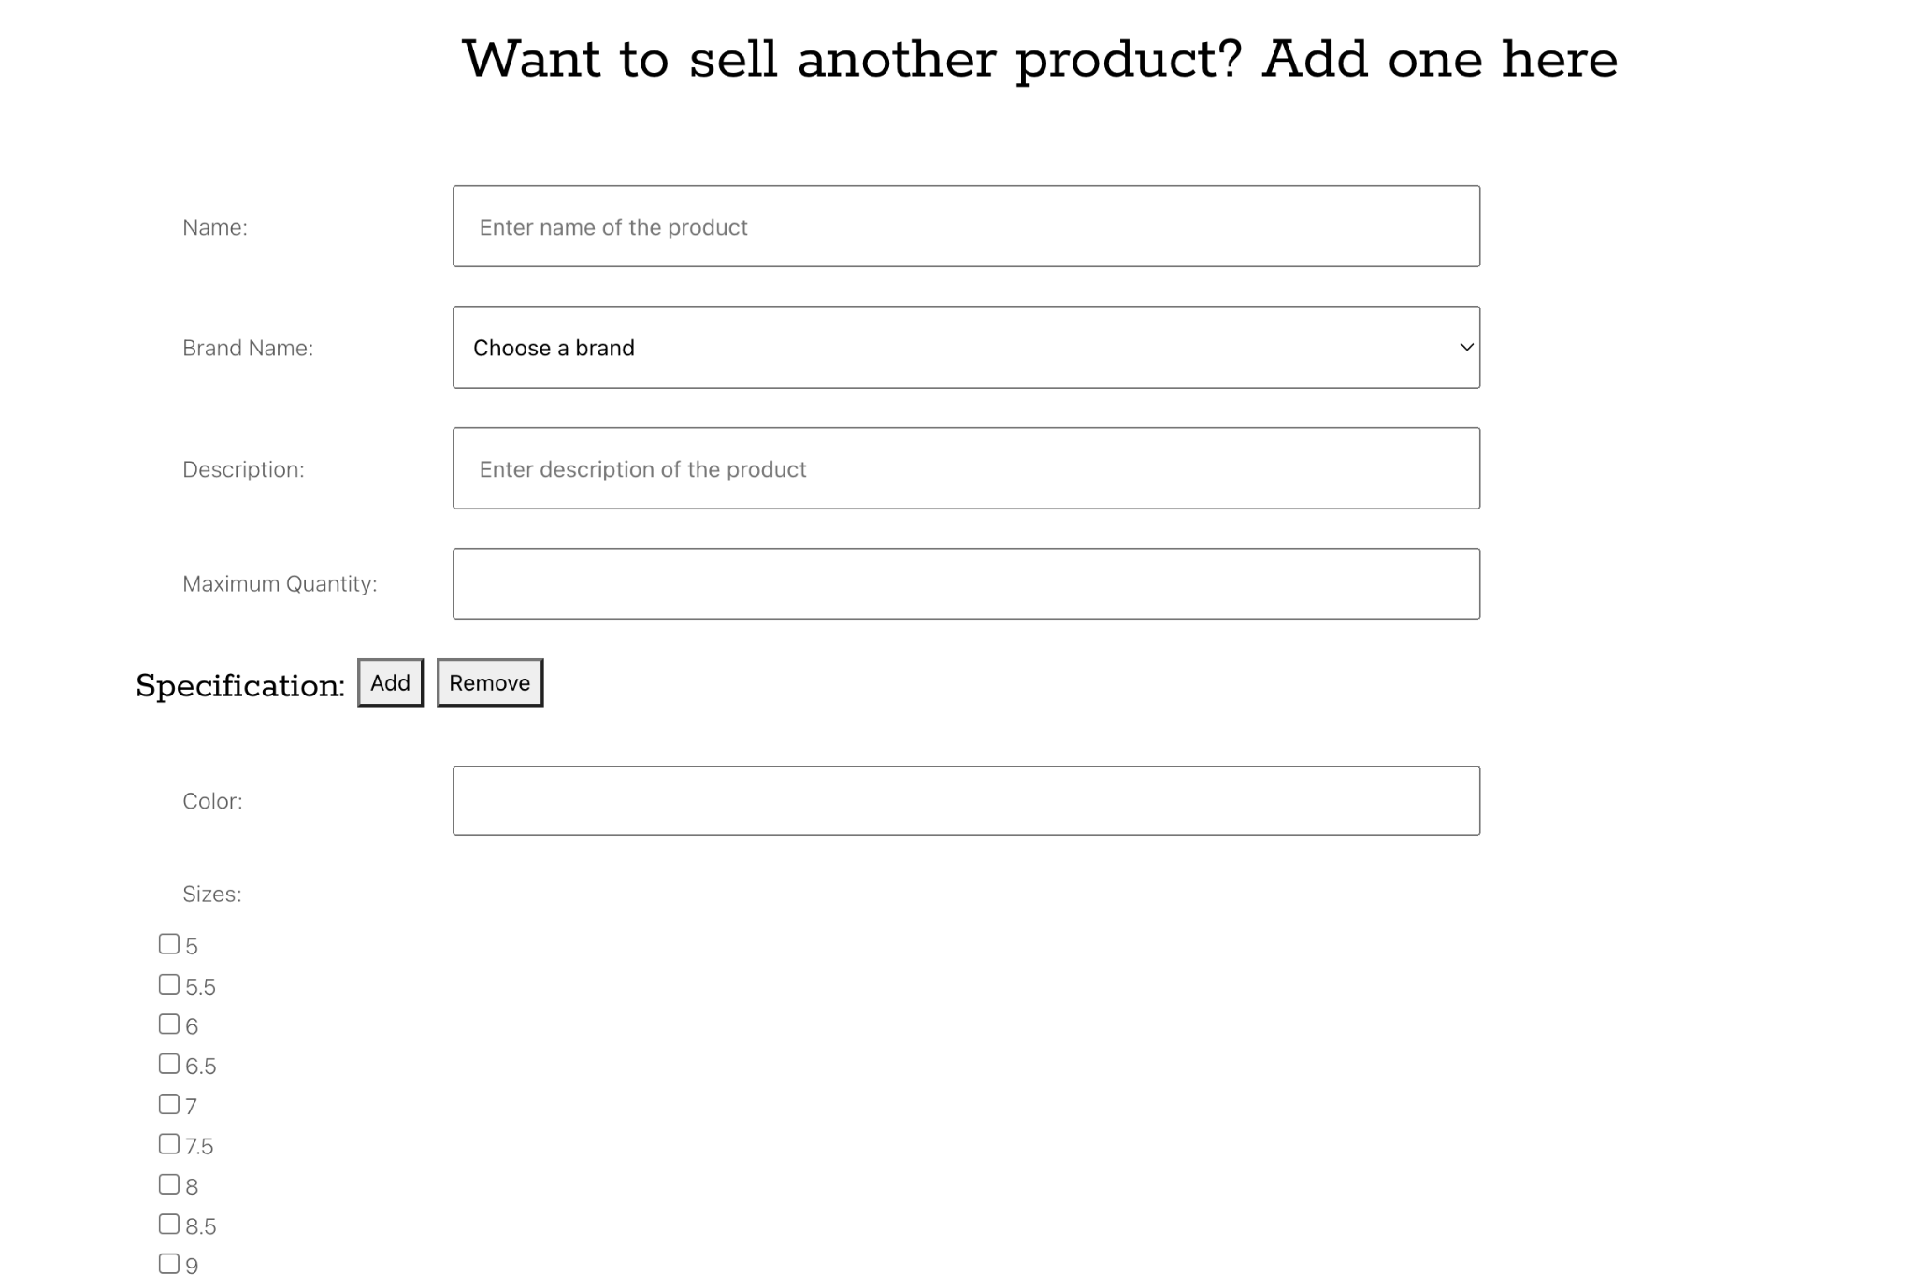
Seller Page (Completed)

Slide 5
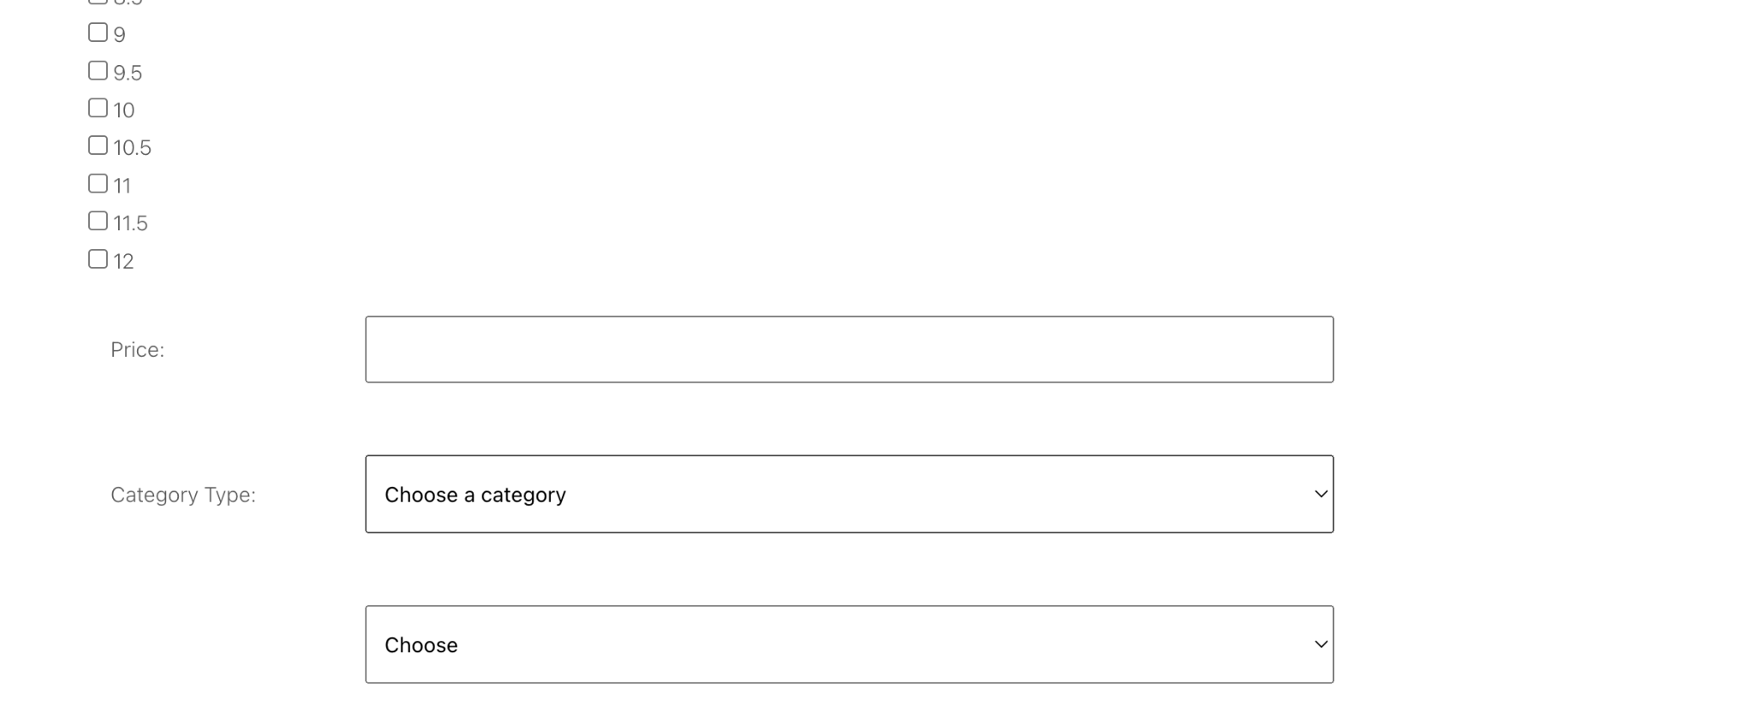
Seller Page (Completed)

Slide 6
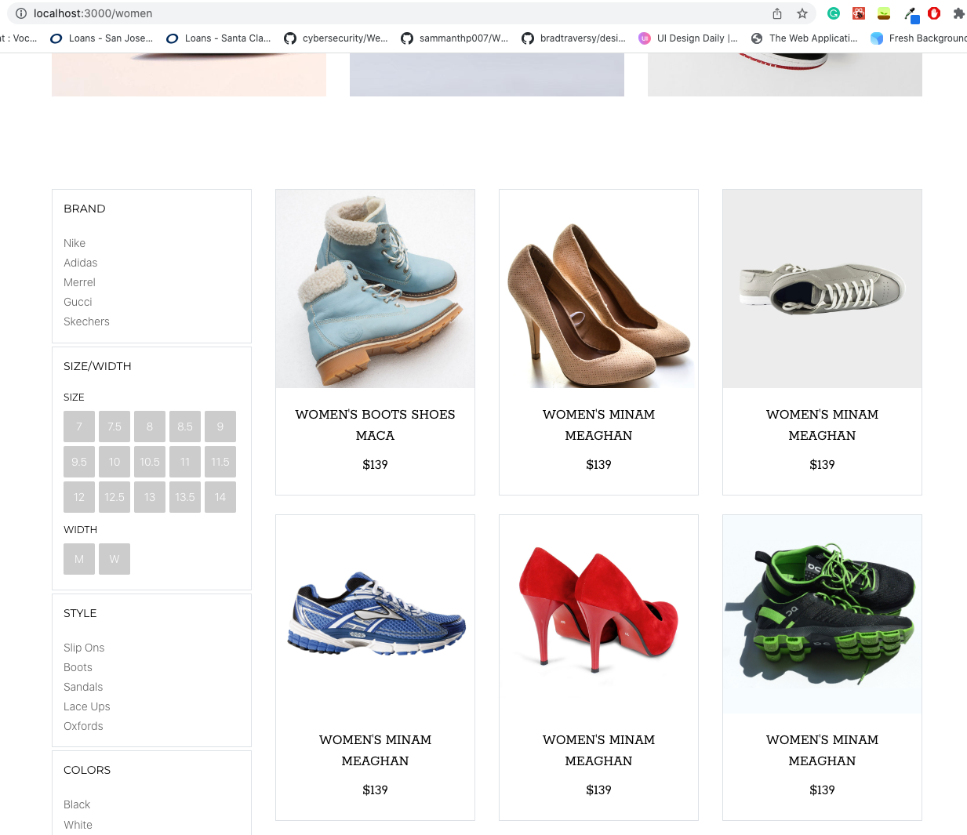
Product Listing

Slide 7
Milestones
M1
Seller Page
M2
Shopping Cart
M3
Men/Women
Best Sellers
M4
User Auth
Order Summary
M5
Checkout/Payment

Slide 8
Hosting methods
AWS EC2: For frontend application and backend server
AWS S3: For storing product images
MongoDB Atlas: For hosting Mongo DB

Slide 9
Feedback from Thrive Today
Running the backend is a little tricky because the .env file needs to be shared each time.
UI looks good and the website is easy to navigate
Easy to setup

Slide 10
Response to Feedback
The website is now hosted so running should be easy to do

Slide 11
Thanks!

